Slide 1
Setting up a new restaurant in New York City
Tiago Ribeiro
July 2020

Slide 2
Introduction
The Business Problem that I wish to help solve is basically in which neighborhood of New York city should a cook/business man build his new restaurant, given the fact that Manhattan is already a place filled with many many restaurants of several cultures.
“you can’t walk a New City block without passing a restaurant”. It even states that “80 percent of restaurants fail within five years” (https://vinepair.com/booze-news/new-york-restaurants-eat-at-every-on/)

Slide 3
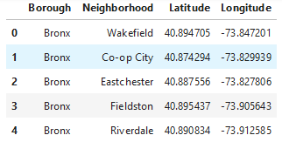
The Data
Foursquare API will be the chosen API to collect the data related to the venues for each geographical point.
The Source data for the NY City locations should have the following format (after interpreting the JSON file):

Slide 4

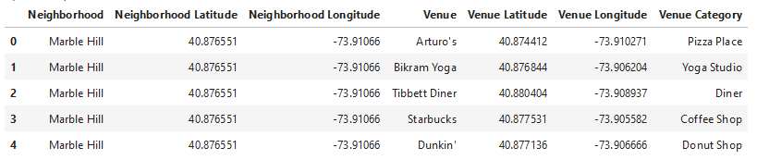
The Data
The data for the venues to be analyzed should have the following format:

Slide 5
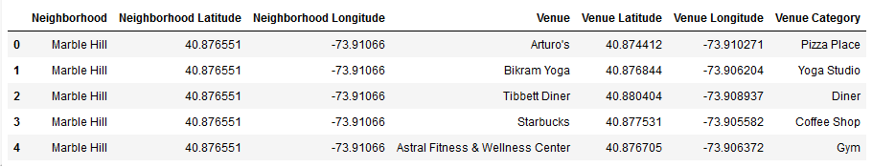
Methodology
First and foremost, the venues of each Manhattan location described in the Data section of this report, were retrieved from Foursquare’s API, with the output being a dataframe with following structure:

Slide 6
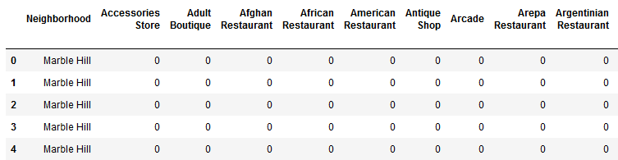
Methodology
Then the one-hot coding procedure was done in order to get a matrix with the neighborhoods on the left side and the column names being the type of venue, with 1s marking if the current venue exists for a given location and 0s marking the opposite:

Slide 7
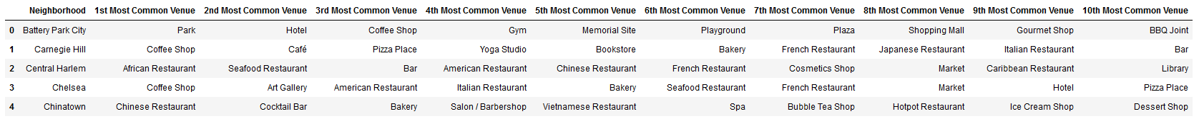
Methodology
Then the data would be structured in the form that will be essential for this case study and will be used for Machine Learning (ML) algorithms:

Slide 8
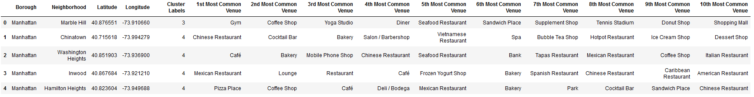
Methodology
After using clustering to allow us to label our data:

Slide 9
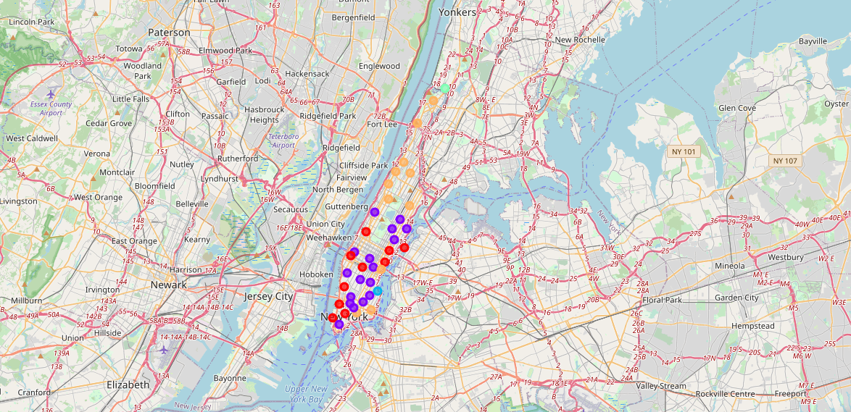
Methodology
K = 5 Clusters

Slide 10
Methodology – Using a new test entry to obtain the candidate cluster
8 – Park
11 – Clothing Store
11 – Plaza
11 – Coffee Shop
12 – American Restaurant
1 – Spa
20 – Dog Run
7 – Liquor Store
0 – Donut Shop
20 - Thai Restaurant

Slide 11
Results
ML Techniques Accuracy Scores
Algorithm | Jaccard | F1-score
KNN | 0.625 | 0.643
Decision Tree | 0.375 | 0.383
SVM | 0.625 | 0.625
Logistic Regression | 0.625 | 0.611
KNN was selected to check the label for our candidate cluster, thus cluster 1 was obtained!

Slide 12
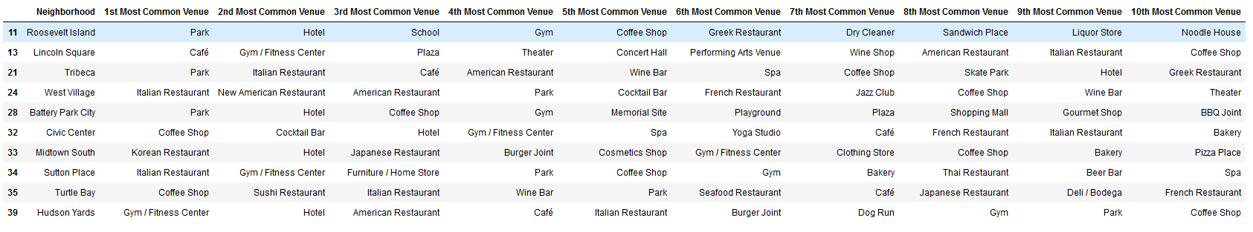
Results
Cluster 1

Slide 13
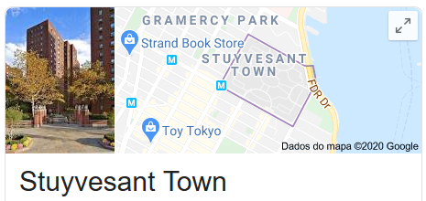
Discussion
Cluster 3, which only has the neighborhood Stuyvesant Town, can be discarded since by just googling location we notice that this is a large private residential development, which are usually not a great ideal place to build your restaurant.
Cluster 4 can also be discarded, but for a different reason. We only have one entry for this particular cluster which, if the model’s chosen label were to be this one, would not be a result giving us great confidence in it.
In cluster 5 restaurants are predominant, thus it isn’t a good choice!

Slide 14
Discussion
Cluster 2 has the following statistics:
Which features a great predominance of restaurants with a total number of 20 most common restaurants (not counting the Pizza Places). In contrast with cluster 1, which has the following statistics:

Slide 15
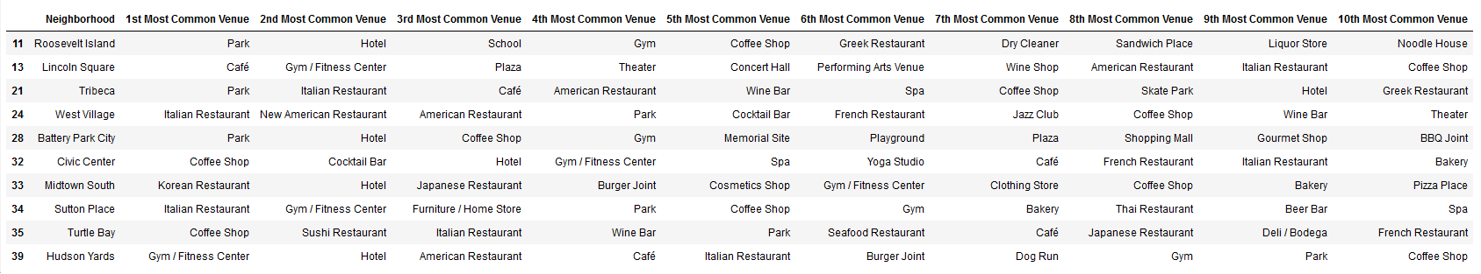
Discussion
Looking back at Cluster 1’s dataframe:

Slide 16
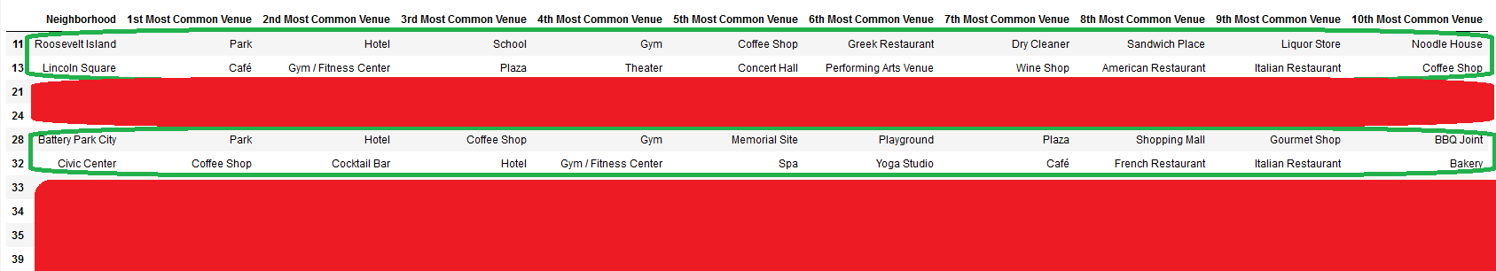
Discussion
We can already discard neighborhoods Tribeca, West Village, Midtown South, Sutton Place, Turtle Bay and Hudson Yards because they have restaurants at least as their 3rd most common venue. Leaving us with just Roosevelt Island, Lincoln Square, Battery Park City and Civic Center neighborhoods.

Slide 17
Discussion
Then in order to choose just one neighborhood, we started to analyze from left to right until we found the first neighborhood with a restaurant as its most common venue, which is Roosevelt Island with a Greek Restaurant as its 6th most common venue.
Again, reading from left to right, we get to the “8th Most Common Venue” column, which has, for both Lincoln Square and Civic Center a restaurant. We eliminate these entries and reach the conclusion that our best choice of a neighborhood is Battery Park City, featuring virtually no restaurant as its most common venue, featuring entries such as Park and Plaza which are in the single-entry dataframe that we used as test data.

Slide 18
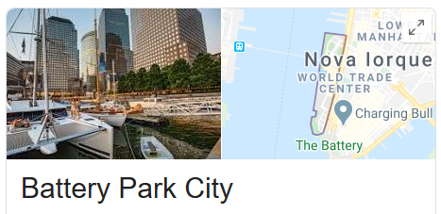
Discussion
Our Winner!

Slide 19
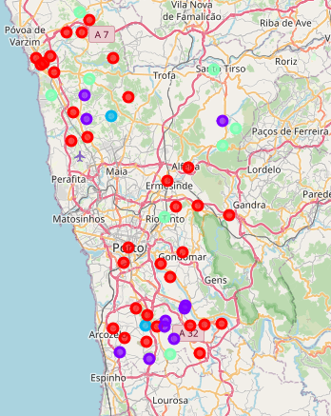

Discussion
Now which type of restaurant do we build? -> Porto as the most different city overall
Portuguese Cuisine is the differentiator!

Slide 20
Conclusion
Lack of geographical points to some cities (like Porto for example, in which the entire district of Porto had to be considered and not just the city itself)
An American restaurant is in that same dataframe, but I opted for a more realistic approach, since it is difficult to assume that in New York City, a place already filled up to the top with so many restaurants (as discussed in the Introduction section), would have a neighborhood with no restaurants whatsoever.
The test data set could be, of course, enhanced in order to feature more entries to check the validity of the model according to the results obtained in this work.
And, also, many more cities could have been researched upon in order to place the new restaurant, however New York City, as it was shown, proved to be a great challenge.

Slide 21

Thank you

